Slide 1
Chapter 14 Notes

Slide 2
Chapter 14: Theories of Personality
Case Study: You Are What Makes You Laugh
Section 1: The Trait Approach
Section 2: The Psychoanalytic Approach
Section 3: The Learning Approach
Section 4: The Humanistic and Sociocultural Approaches
Lab: Applying What You’ve Learned

Slide 3
Case Study: You Are What Makes You Laugh
Everybody loves to laugh, but what does your humor style say about your personality? A person who uses put-down humor may do so as an acceptable way to channel aggression, while a person who always uses self-deprecating humor may do so as a result of their self-loathing. People who tell jokes to relieve a tense situation are often warm and good-natured. The ability to laugh in the face of danger can suggest a healthy psyche. What we find funny may also be tied to other aspects of our personalities.
Notes:
–

Slide 4
Section 1 at a Glance
The Trait Approach
Psychologists study personality to discover patterns of feelings, motives, and behavior that set people apart from one another.
Trait theorists attempt to understand personality by focusing on traits, or those aspects of personality that remain stable.
Psychologist Hans Eysenck used two basic dimensions of personality—introversion-extroversion and emotional stability-instability—to organize traits.

Slide 5
Section 1 at a Glance (cont.)
The Trait Approach
The Five Factor Model identifies five basic personality factors: extroversion, agreeableness, conscientiousness, neuroticism, and openness to experience.

Slide 6
The Trait Approach
Main Idea
Psychologists who support the trait approach believe that personality traits are inborn and unchanging. Many trait theorists believe that people can be measured according to five basic personality factors.
Reading Focus
Who have been the most influential trait theorists?
What is the Five-Factor Model?
How do some psychologists evaluate the trait approach?

Slide 7


Is being shy a mental illness?

Slide 8
Trait Theorists
Personality: the patterns of feelings, motives, and behavior that set people apart from one another.
Trait: an aspect of personality that is considered to be reasonably stable.
Hippocrates
Greek physician who believed that the body contains fluids called humors, the combination of which produced personality traits.
Yellow bile: quick-tempered
Blood: warm and cheerful
Phlegm: sluggish and cool
Black bile: melancholic and thoughtful
Notes:
–

Slide 9
Gordon Allport
Cataloged 18,000 human traits in the 1930s
Described physical traits, behavioral traits, and moral traits
Asserted that a person’s behavior is a product of his or her particular combination of traits
Hans J. Eysenck
Eysenck studied two personality dimensions.
Introverts tend to be imaginative and to look inward for their ideas and energy, while extroverts tend to be active and self-expressive and gain energy from interaction with other people.
Stable people are reliable, while unstable people are unpredictable.
Eysenck’s personality types are similar to those of Hippocrates.

Slide 10
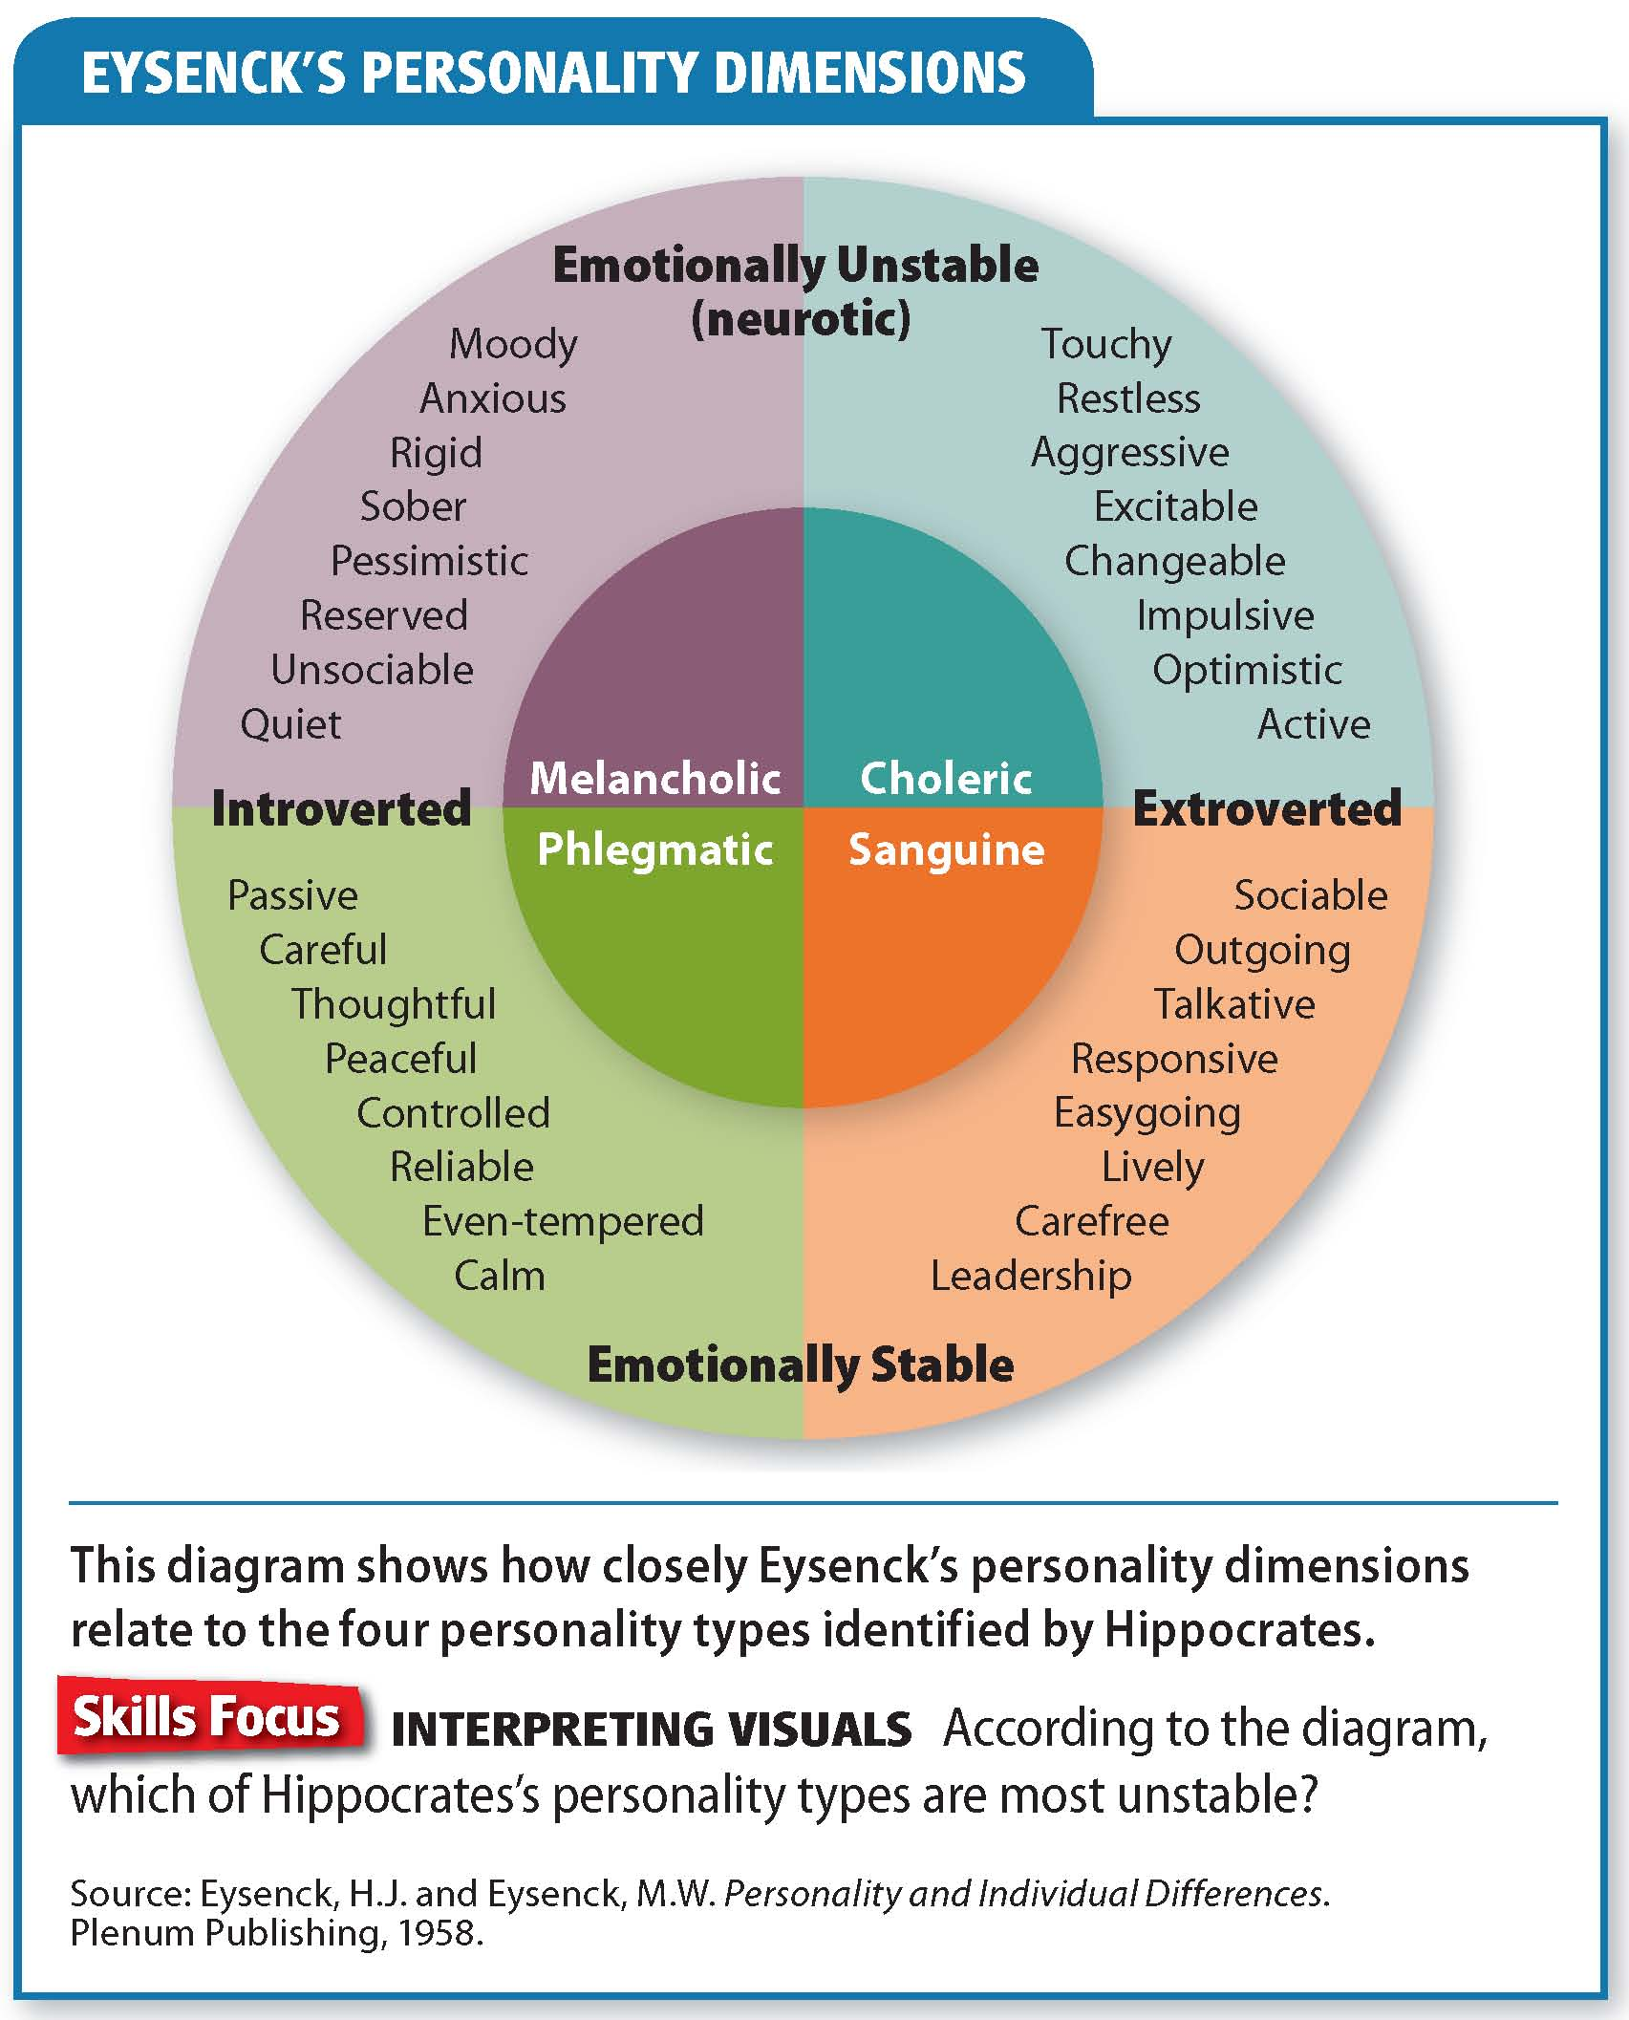

Slide 11
Reading Check
Contrast
How do introverts and extroverts tend to differ?
Answer: Introverts tend to be imaginative and to look inward for their ideas and energy. Extroverts tend to be active and self-expressive and gain energy from interaction with other people.

Slide 12
The Five-Factor Model
Idea that there may be five basic personality factors: extroversion, emotional stability, conscientiousness, agreeableness, and openness to experience
Research on the Five Factors
Links to Disorders
Studies have found correlations between certain behaviors and particular traits.
People who receive many traffic tickets, for example, score lower on the agreeableness scale.
The Five-Factor Model helps psychologists to describe anxiety disorders.
Psychologists still disagree about which factors are the most basic, but nearly all would agree that the “big five” are important.
Notes:
–

Slide 13
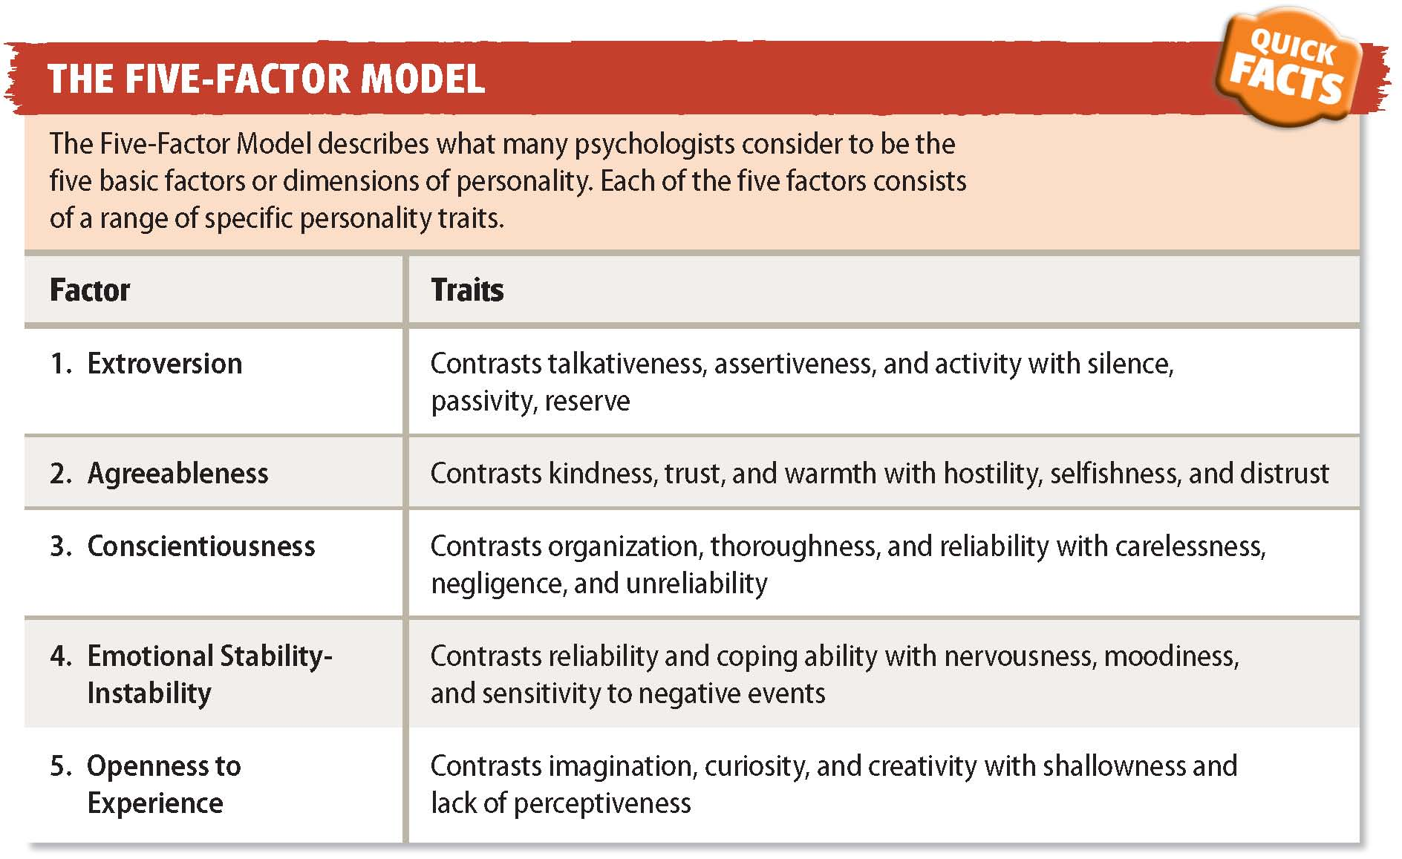

Slide 14
Reading Check
Identify Supporting Details
What does research on the five factors suggest about people’s basic temperaments?
Answer: largely inborn; personalities mature

Slide 15
Evaluation of the Trait Approach
One shortcoming of the trait approach is its singular focus on describing traits.
Efforts to link personality traits to biological factors have not been successful.
This approach suggests that there are links between personalities, abilities, and interests.
It provides no explanation of how personality develops.

Slide 16
Reading Check
Summarize
What are the strengths of the trait approach?
Answer: measures personality traits; matches people to jobs

Slide 17
Section 2 at a Glance
The Psychoanalytic Approach
According to the psychoanalytic approach, personality is shaped by inner struggles that all people experience.
The psychoanalytic approach is based on Sigmund Freud’s theories about the structure of the mind, defense mechanisms, and the stages of personality development.
Many of Freud’s intellectual heirs have made unique contributions to the psychoanalytic approach.

Slide 18
The Psychoanalytic Approach
Main Idea
The psychoanalytic approach stresses the influence of the unconscious on personality. Freud, Jung, Adler, Horney, and Erikson are among the most important psychoanalytic theorists.
Reading Focus
What theories did Sigmund Freud develop about the mind?
Why do people use defense mechanisms?
What are Freud’s main stages of personality development?
Who are other important psychoanalytic theorists?
How do psychologists evaluate the psychoanalytic approach?

Slide 19
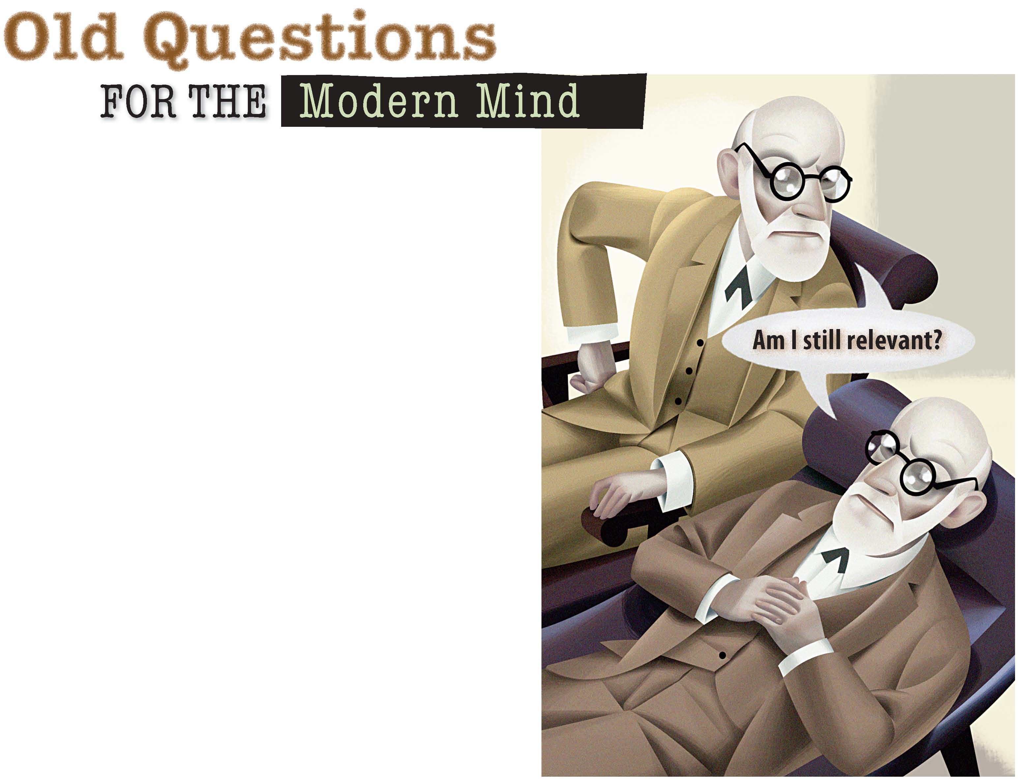
Can psychoanalysis stand the test of time?

Slide 20
Sigmund Freud
The psychoanalytic approach to personality teaches that all people undergo inner struggles. People are born with certain biological drives such as aggression, sex, and the need for superiority. These drives come into conflict with laws, norms, and moral codes.
The Unconscious
Freud believed that conscious ideas and feelings occupy only a small part of the mind. Deepest thoughts, fears, and urges remain out of their awareness.
Psychoanalysis urges people to discuss whatever is on their minds, sometimes called a “talking cure.”
Freud also used dream analysis and hypnosis to access the unconscious.

Slide 21
The Id
Behaves like a stereotypical two-year-old, represents basic drives such as hunger. It demands instant gratification and pays no attention to rules or others. Follows the pleasure principle.
The Ego
Develops because demands for instant gratification cannot be met immediately or safely. Guided by the reality principle—the understanding that we cannot always get what we want.
Most of the ego is conscious, but it works in the unconscious to censor the impulses of the id and balance the rules of the superego.
The Superego
Develops throughout early childhood, follows the moral principle. It incorporates the standards and values of parents and society. Provides us with our moral sense and acts as our conscience.

Slide 22
Reading Check
Identify Supporting Details
How did Sigmund Freud think the human mind was organized?
Answer: into three basic psychological structures: the id, the ego, and the superego

Slide 23
Defense Mechanisms
Defense mechanisms are methods the ego uses to avoid recognizing ideas or emotions that may cause anxiety. These defenses operate unconsciously.
Repression
Rationalization
It removes anxiety-causing ideas from conscious awareness by pushing them into the unconscious.
Freud likened repression to keeping a lid on a boiling kettle.
When enough pressure builds up, outbursts of anger or other problems develop.
Rationalization is the use of self-deception to justify unacceptable behaviors or ideas.
It can protect one’s self-esteem or self-concept, but can also mask the real problem and prevent the person from dealing with the situation.
Notes:
–

Slide 24
Regression
Regression is returning to behavior that is characteristic of an earlier stage of development when faced with stress.
Regression is usually temporary, but becomes a problem when it is used to avoid adult behavior.
Projection
Projection is dealing with unacceptable impulses by projecting these impulses outward onto other people.
People see their own faults in other people.
Effects of Defense Mechanisms
When used in moderation, defense mechanisms are normal and useful.
They become unhealthy when they lead a person to ignore the underlying issues causing the feelings.

Slide 25
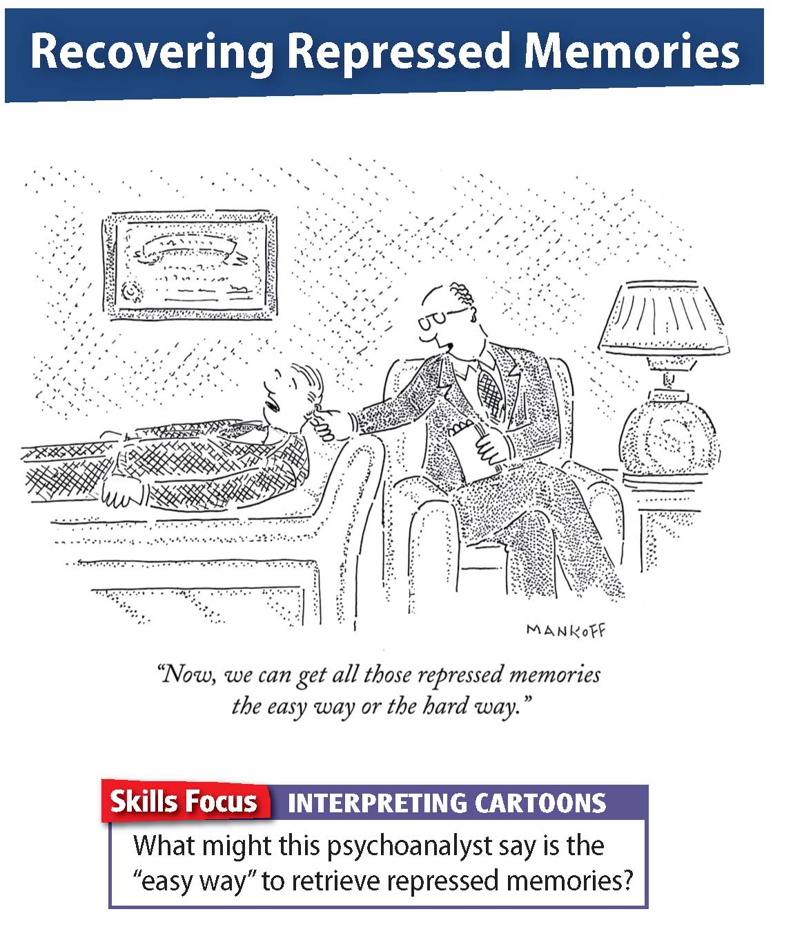

Slide 26
Reading Check
Summarize
What are some common defense mechanisms?
Answer: repression: pushing anxiety-causing ideas into the unconscious; rationalization: self-deception to justify unacceptable behaviors; regression: returning to behavior from an earlier stage of development; and projection: projecting unacceptable impulses outward onto other people

Slide 27


Slide 28
Stages of Personality Development
Freud believed an individual’s development went through five stages.
These stages begin at birth and continue through adolescence.
He claimed people instinctively seek to preserve and extend life.
Psychological energy labeled libido (desire) is one of the most controversial personality theories.
The Oral Stage
Begins in the first year of life
Infants begin exploring the world by putting things in their mouths, and receive their main source of pleasure—food—orally.
A child whose caretakers do not meet the infant’s needs during this time may become fixated at the oral stage, resulting in smoking, overeating, or nail biting.

Slide 29
The Anal Stage
Older infants learn that they can control their bodily functions, and self-control becomes vital.
Fixation at this stage can result in anal-retentive behavior such as excessive self-control or anal-expulsive traits such as messiness.
The Phallic Stage
Begins at age three, when children discover the physical differences of the two sexes and become focused on their own bodies.
Fixation at this stage can result in disorders such as depression and anxiety.
The Latency Stage
By age 5 or 6, children have been in conflict with parents for many years, and so retreat from the conflict.
Impulses remain hidden, or “latent.”
The Genital Stage
People enter this final stage at puberty.
Teens do not encounter any new psychological conflicts, but earlier conflicts resurface.

Slide 30
Reading Check
Sequence
At what age do each of the stages of development occur?
Answer: oral—first year of life; anal—between one and a half to two and a half years; phallic—three; latency—five or six; genital—puberty

Slide 31
Other Important Theorists
Carl Jung
Jung was a colleague of Freud, but fell into disfavor when he developed his own psychoanalytic theory, known as analytic psychology.
Analytic psychology places a greater emphasis on the influences of shared symbols and religion on human behavior.
He argued that people inherit a collective unconscious: a store of human concepts shared by all people across all cultures.
The components of the collective unconscious are primitive concepts called archetypes: ideas and images of the accumulated experience of all human beings.
Although these images remain unconscious, they appear in dreams.
Jung believed that consciousness was characterized by four functions: thinking, feeling, intuition, and sensation.
Individuation: creating a healthy personality by integrating conscious and unconscious elements

Slide 32
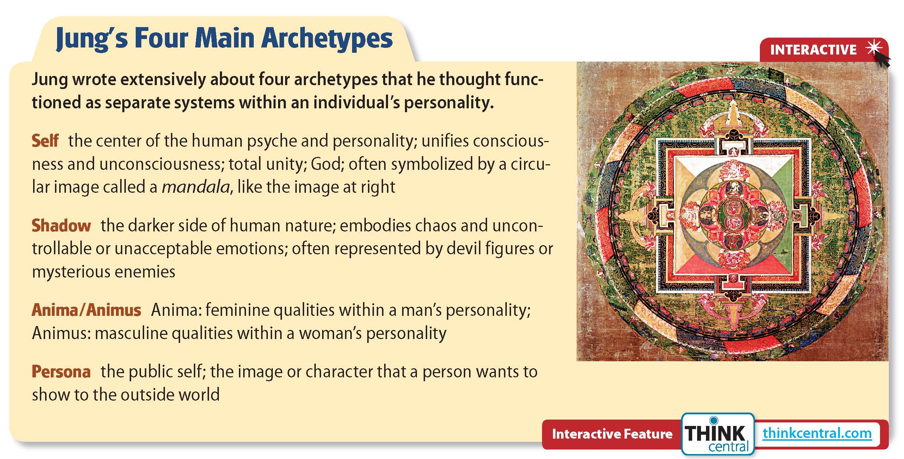
Click on the image to play the Interactive.

Slide 33
Reading Check
Find the Main Idea
What is Jung's theory of the collective unconscious?
Answer: that all humans have an inherited store of concepts shared by all people across all cultures

Slide 34
Alfred Adler
Believed people are motivated by a need to overcome feelings of inferiority that he called inferiority complex
Introduced the idea of sibling rivalry to describe jealousies among brothers and sisters
Karen Horney
Believed childhood experiences play a major role in the development of adult personalities
When parents treat children with indifference or harshness, children develop feelings called basic anxiety
Erik Erikson
Believed social relationships are most important factors in personality development
Expanded Freud’s idea of ego and labeled later stages of development

Slide 35
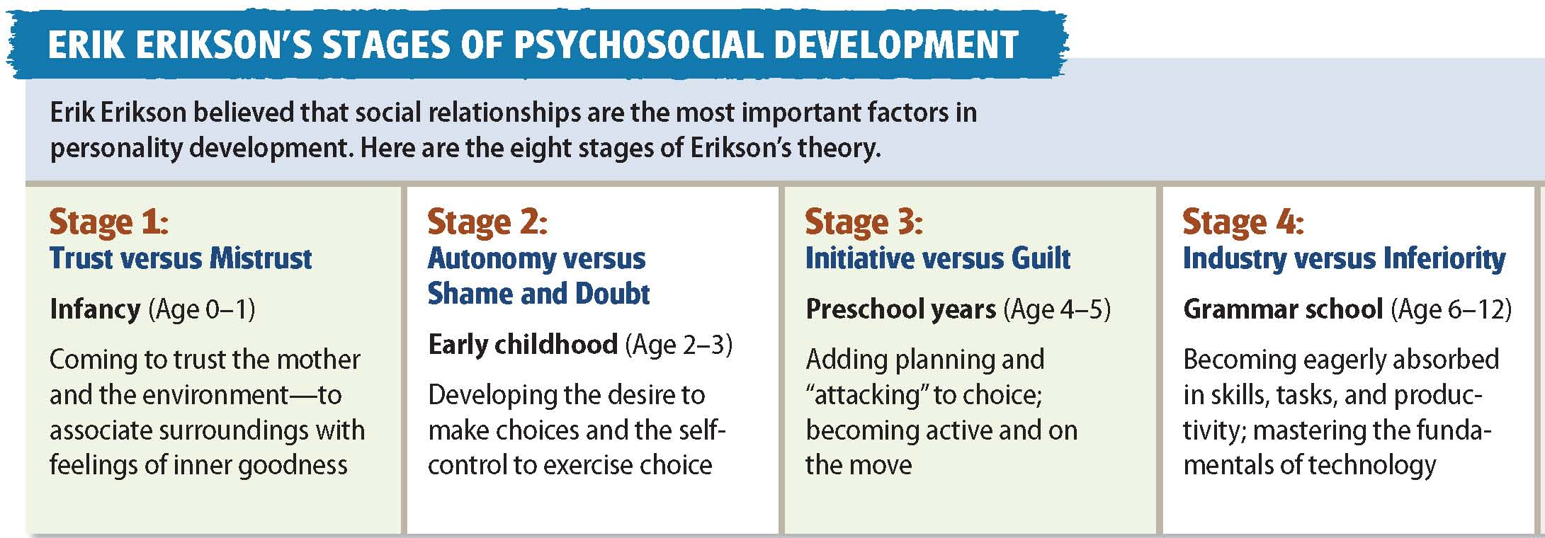
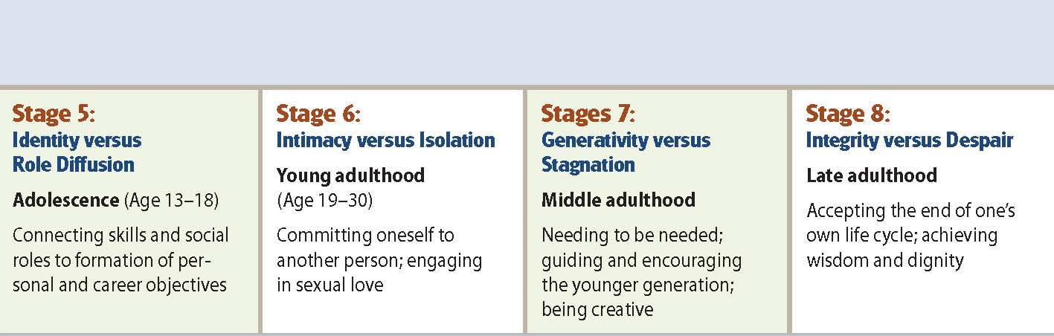

Slide 36
Reading Check
Compare
How are the views on childhood of Adler, Horney, and Erikson similar?
Answer: All theorized that early childhood relationships affect us throughout our lives.

Slide 37
Evaluation of the Psychoanalytic Approach
Freud was an important champion of the idea that human personality and behavior can be studied scientifically.
Psychoanalytic theory focused attention on childhood events.
Help recognize that sexual and aggressive urges are common, and that there is a difference between recognizing these urges and acting upon them.
Criticisms include:
Too much emphasis on unconscious motives
Neglected the importance of social relationships
Methods for gathering evidence
Evidence only from white, middle-class individuals who sought help

Slide 38
Reading Check
Analyze
What important contributions has Freud made to psychology?
Answer: demonstrated human personality and behavior are subject to scientific analysis, showed compassion for people with psychological disorders, focused scientists and therapists on effects of childhood, heightened awareness of emotional needs of children

Slide 39
Psychology in Today’s World
Password to Personality
Most people pick computer passwords quickly, while others think long and hard. Regardless of how you devise your login, chances are it will be easier to crack than you think.
Most people choose passwords that reflect their personal lives and interests.
One study says passwords are unintentionally revealing because people tend to choose the first things that come to mind.
Four distinct types: family, fan, fantasists, and cryptics
Family: name, nickname, or birth date of self or family member
Fan: names of athletes, movie stars, singers, or fictional characters
Fantasists: interest in a fantasy identity such as “goddess”
Cryptics: mixing letters, numbers, symbols, and punctuation
Notes:
–

Slide 40


Slide 41
Thinking Critically
What personality characteristics characterize each of the four main types of password users?
How do you select your computer passwords? What do they reveal about your personality?

Slide 42
Section 3 at a Glance
The Learning Approach
The two branches of the learning approach, behaviorism and social-learning theory, focus on how experiences shape behavior.
Behaviorists assert that people learn socially desirable behaviors through a process called socialization.
Social learning theorists argue that people learn by observation.

Slide 43
The Learning Approach
Main Idea
The learning approach has two branches: behaviorism and social-learning theory. Behaviorists believe that our actions are learned. Social-learning theorists think that we learn by observation.
Reading Focus
What are some of the beliefs behind behaviorism?
How do social-learning theorists approach learning?
Why are some psychologists dissatisfied with the learning approach?

Slide 44


Who do you want to become?

Slide 45
Behaviorism
The learning approach emphasizes the effects of experience on behavior. Your behaviors reflect what you have been rewarded or reinforced for.
John Watson and B. F. Skinner
Socialization
Watson claimed external influences shape people’s preferences and behavior.
Skinner emphasized the effects of reinforcement on behavior and rejected trying to see within people’s minds as unscientific.
Watson and Skinner discarded ideas of personal freedom, choice, and self-direction in favor of external influences such as parental approval.
Socialization: the process by which people learn socially desirable behaviors
Notes:
–

Slide 46
Reading Check
Summarize
According to behaviorists, how do people learn acceptable behavior?
Answer: through socialization and reinforcement

Slide 47


Slide 48
Social-Learning Theory
Focuses on the importance of learning by observation, and on the role of the cognitive processes that produce individual differences
Albert Bandura
Bandura argued that practically any behavior that could be learned from direct experience could also be learned by observing and modeling other people.
One study showed that children who witnessed a violent action were more likely to repeat that action
Another study showed that children would not copy an adult’s behavior if the adult was punished for that behavior
These studies suggest that children learn what society deems acceptable behavior by watching and modeling others

Slide 49
Social Cognitive Theory
Personality is shaped and learning is acquired by the interaction of:
Personal factors (thoughts, beliefs, values, genetic makeup)
Behavior (one’s actions and experience)
Environmental factors (social, cultural, and political forces)
Presents a way to understand and predict human behavior
Purposeful Learning
Individuals seek to learn about their environments and have a certain degree of control over reinforcement. Behavior is not based solely on observation, and internal variables influence how we act.
Internal factors: skills, values, goals, expectations, self-efficacy expectations

Slide 50
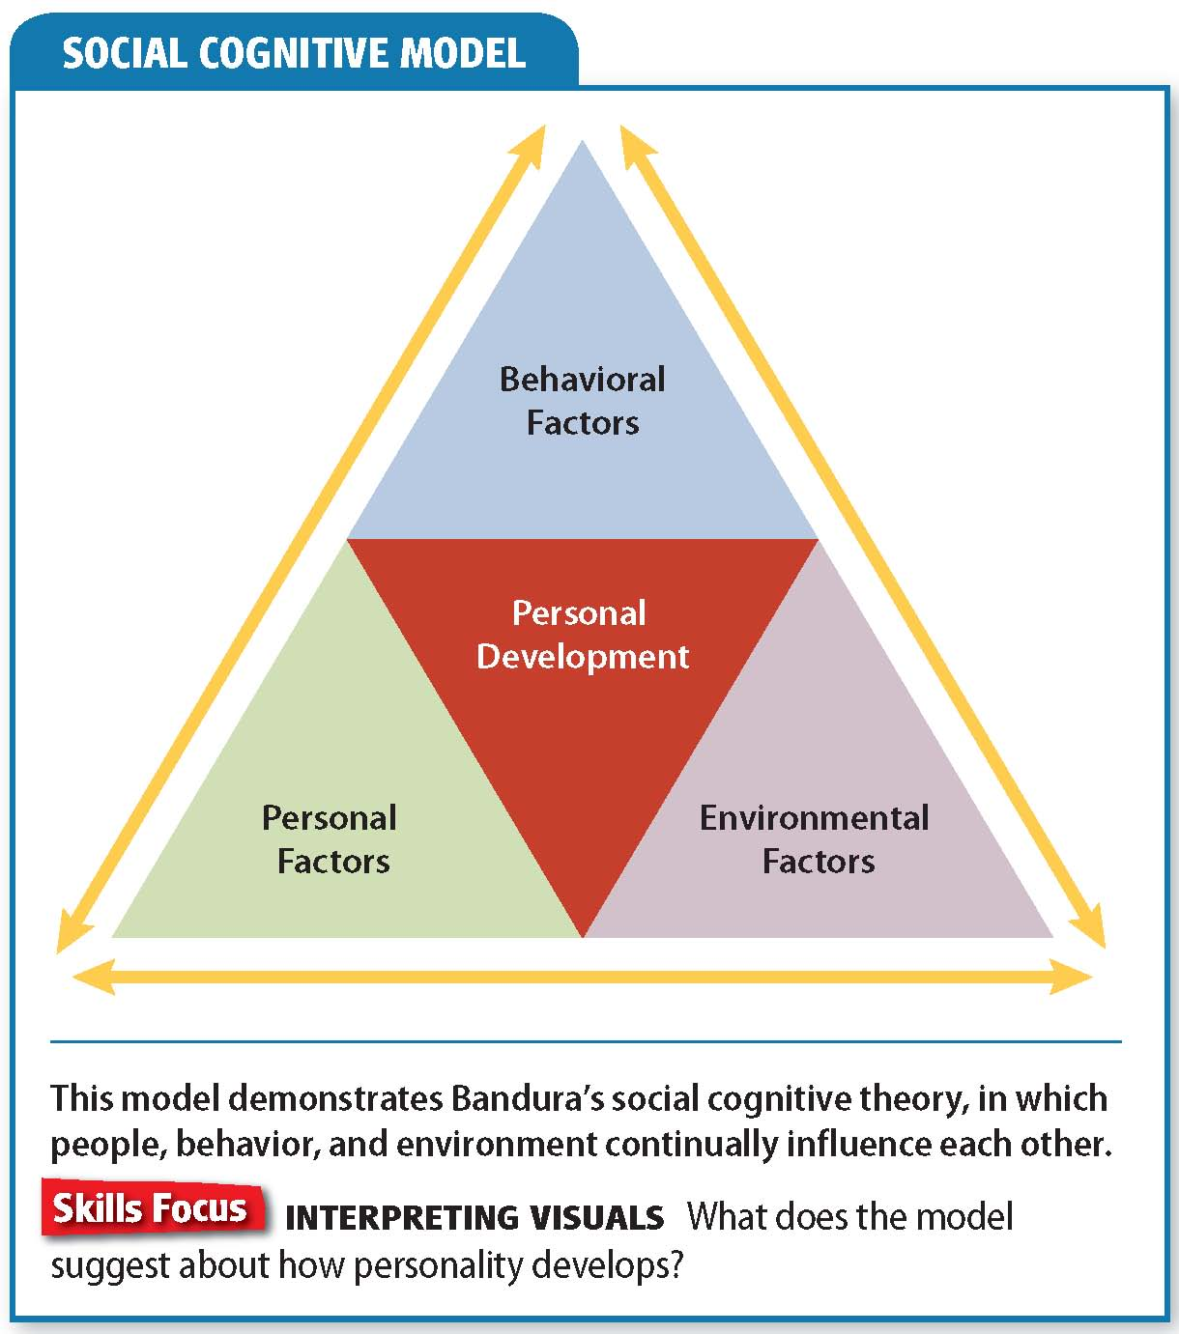

Slide 51
Reading Check
Identify Supporting Details
What is social cognitive theory?
Answer: Personal, behavioral, and environmental factors influence our personality and learning.

Slide 52
Evaluation of the Learning Approach
Learning theory has made key contributions to the understanding of behavior, but it has also left some psychologists dissatisfied.
Behaviorism does not describe, explain, or even suggest the richness of inner human experience. It does not deal with thoughts, feelings, or inner maps.
Social-learning theory attempts to deal with these issues, but critics say it is not satisfactory.

Slide 53
Reading Check
Contrast
In what way do learning theorists disagree with psychoanalytic theorists?
Answer: Learning theorists emphasize the influence of environment.

Slide 54
Section 4 at a Glance
The Humanistic and Sociocultural Approaches
The humanistic perspective emphasizes the importance of free choice, self-awareness, self-fulfillment, self-esteem, and ethical conduct in personality development.
Psychologists following the sociocultural approach focus on how gender, ethnicity, and culture influence personality.

Slide 55
The Humanistic and Sociocultural Approaches
Main Idea
Humanistic psychologists believe that people shape their personalities through free choice and action. Sociocultural psychologists focus on the roles of ethnicity, gender, and culture in personality formation.
Reading Focus
What is the focus of humanistic psychology?
Who is Carl Rogers?
How do psychologists evaluate the humanistic approach?
What is sociocultural psychology?
How does the sociocultural approach view personality development?

Slide 56
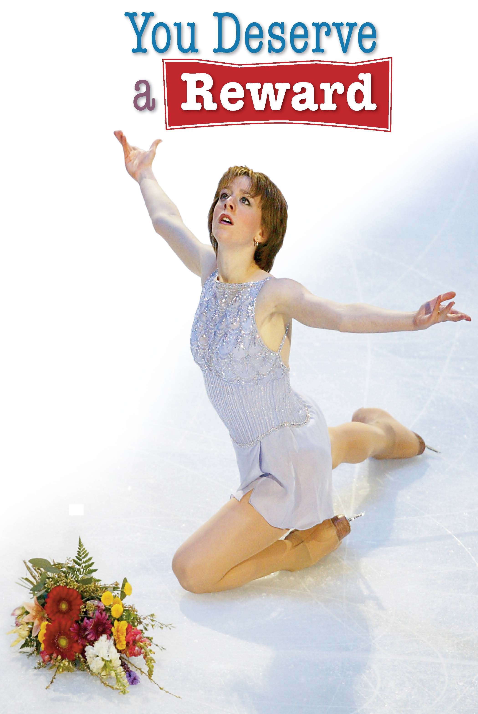
How do you want to be rewarded for a great performance?

Slide 57
Humanistic Psychology
Behaviorists argue that psychologists should not attempt to study self-awareness. Humanists, however, begin with the assumption that self-awareness is the core of humanity.
Abraham Maslow
Hierarchy of Needs
Maslow believed humans are separated from lower animals by the drive to reach their potential.
Each person is unique and must follow his or her own path.
Following a personal path involves taking risks.
Five levels of needs
Physiological needs (water, food)
Security needs (safety, shelter)
Social needs (love, belonging)
Esteem needs (respect)
Self-actualization needs (self-awareness, personal growth)
Notes:
–

Slide 58
Reading Check
Identify Supporting Details
What is self-actualization?
Answer: the ability of people to reach full potential

Slide 59
Carl Rogers
Advocate of the humanistic approach
Believed people are basically good and mentally healthy
Said that people to some degree are the architects of their own personalities.
Termed self theory
Self-concept: a view of oneself as an individual
The self is concerned with recognizing personal values and establishing a sense of one’s relationships to other people
Notes:
–

Slide 60
The Self-Concept and Congruence
Self-concepts are made up of our impressions of ourselves and our evaluations of our adequacy.
The key to happiness is congruence, or consistency between one’s self-concept and one’s experience.
Self-Esteem and Positive Regard
At first, self-esteem reflects the esteem in which others hold us.
We cannot fully live up to the wishes of others and also remain true to ourselves.
The expression of self does not always lead to conflict.
The path to self-actualization requires getting in touch with our genuine feelings and acting on them.

Slide 61
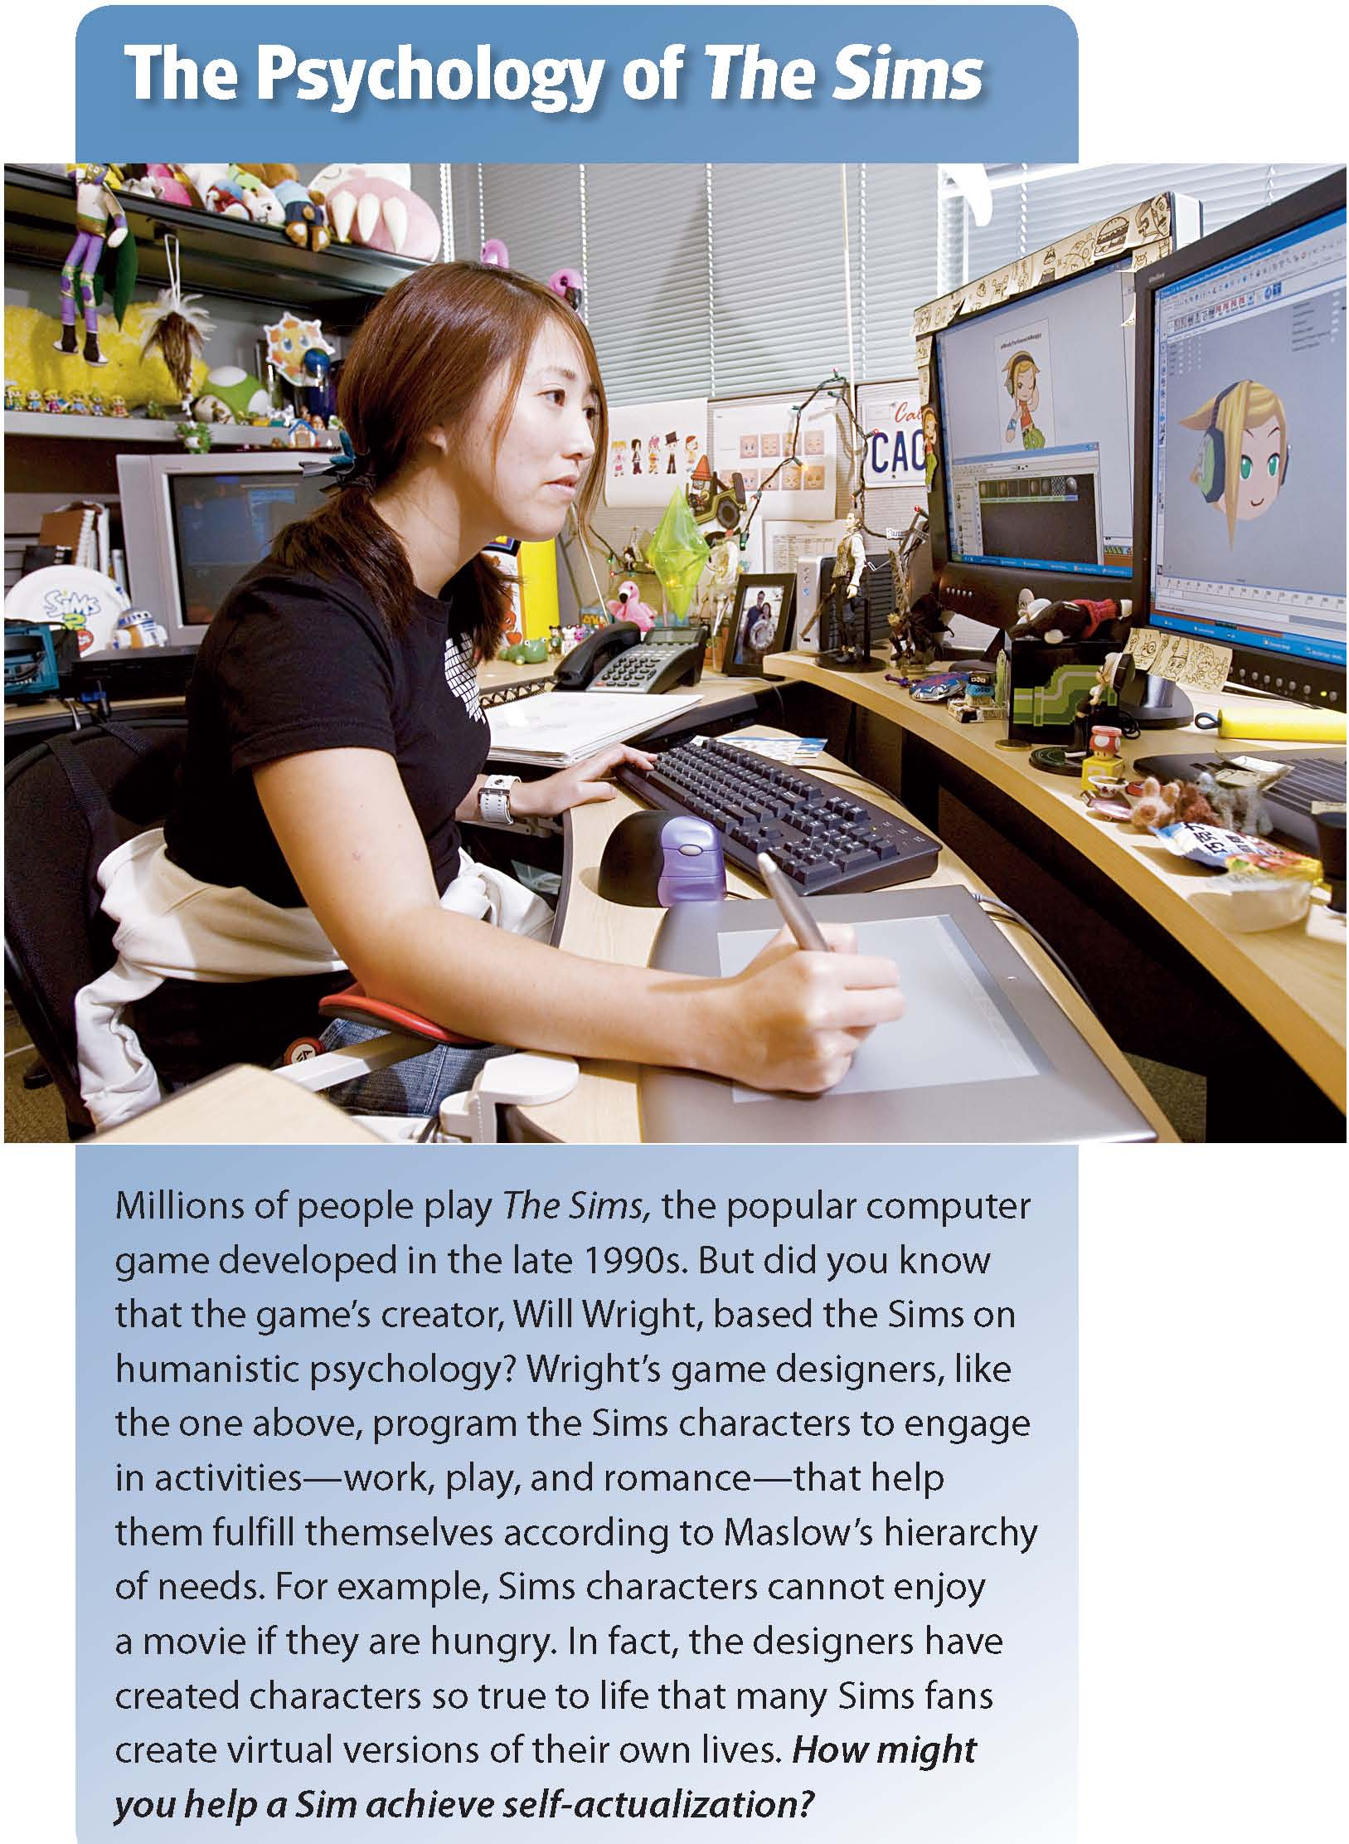

Slide 62
Reading Check
Identify Cause and Effect
What might happen as a result of a parent’s conditional positive regard?
Answer: Children might come to think that they are worthwhile only if they behave in certain ways.

Slide 63
Evaluation of the Humanistic Approach
Humanistic psychologists believe that an essential aspect of human life is conscious experience—the sense of one’s self as progressing through space and time.
Humanistic theories are popular because they grant consciousness a key role and because they stress human freedom.
These strengths are also weaknesses, because each individual’s conscious experience is unique.
Critics note that humanistic theories do not predict the sorts of traits, abilities, and interests that people might develop.

Slide 64
Reading Check
Summarize
Why are humanistic theories popular?
Answer: because they stress human freedom and conscious experience rather than seeing us as products of our childhoods or our circumstances

Slide 65
Sociocultural Psychology
Focuses on the roles that ethnicity, gender, socioeconomic status, and culture play in shaping personality, behavior, and mental processes. Both family and environmental influences are key factors in personality development.
Individualism v. Collectivism
Sociocultural Factors and the Self
Individualists give priority to their personal identities and goals.
Collectivists give priority to goals of the group.
Reliable measure of personality differences between individuals from different cultures
Social and cultural factors affect the self-concept and self-esteem of the individual.
Members of groups that have been discriminated against may have lower self-images.
Notes:
–

Slide 66
Acculturation and Self-Esteem
Personalities are influenced by cultural settings.
A Korean American child, for example, might be influenced by Korean culture at home and American culture at school.
Acculturation: the process of adapting to a new or different culture.
Some immigrants become assimilated, or absorbed, into the culture of the area to which they move.
Other choose to maintain separation, and they retain their language and customs.
Research suggests that people who are bicultural have the highest self-esteem.

Slide 67

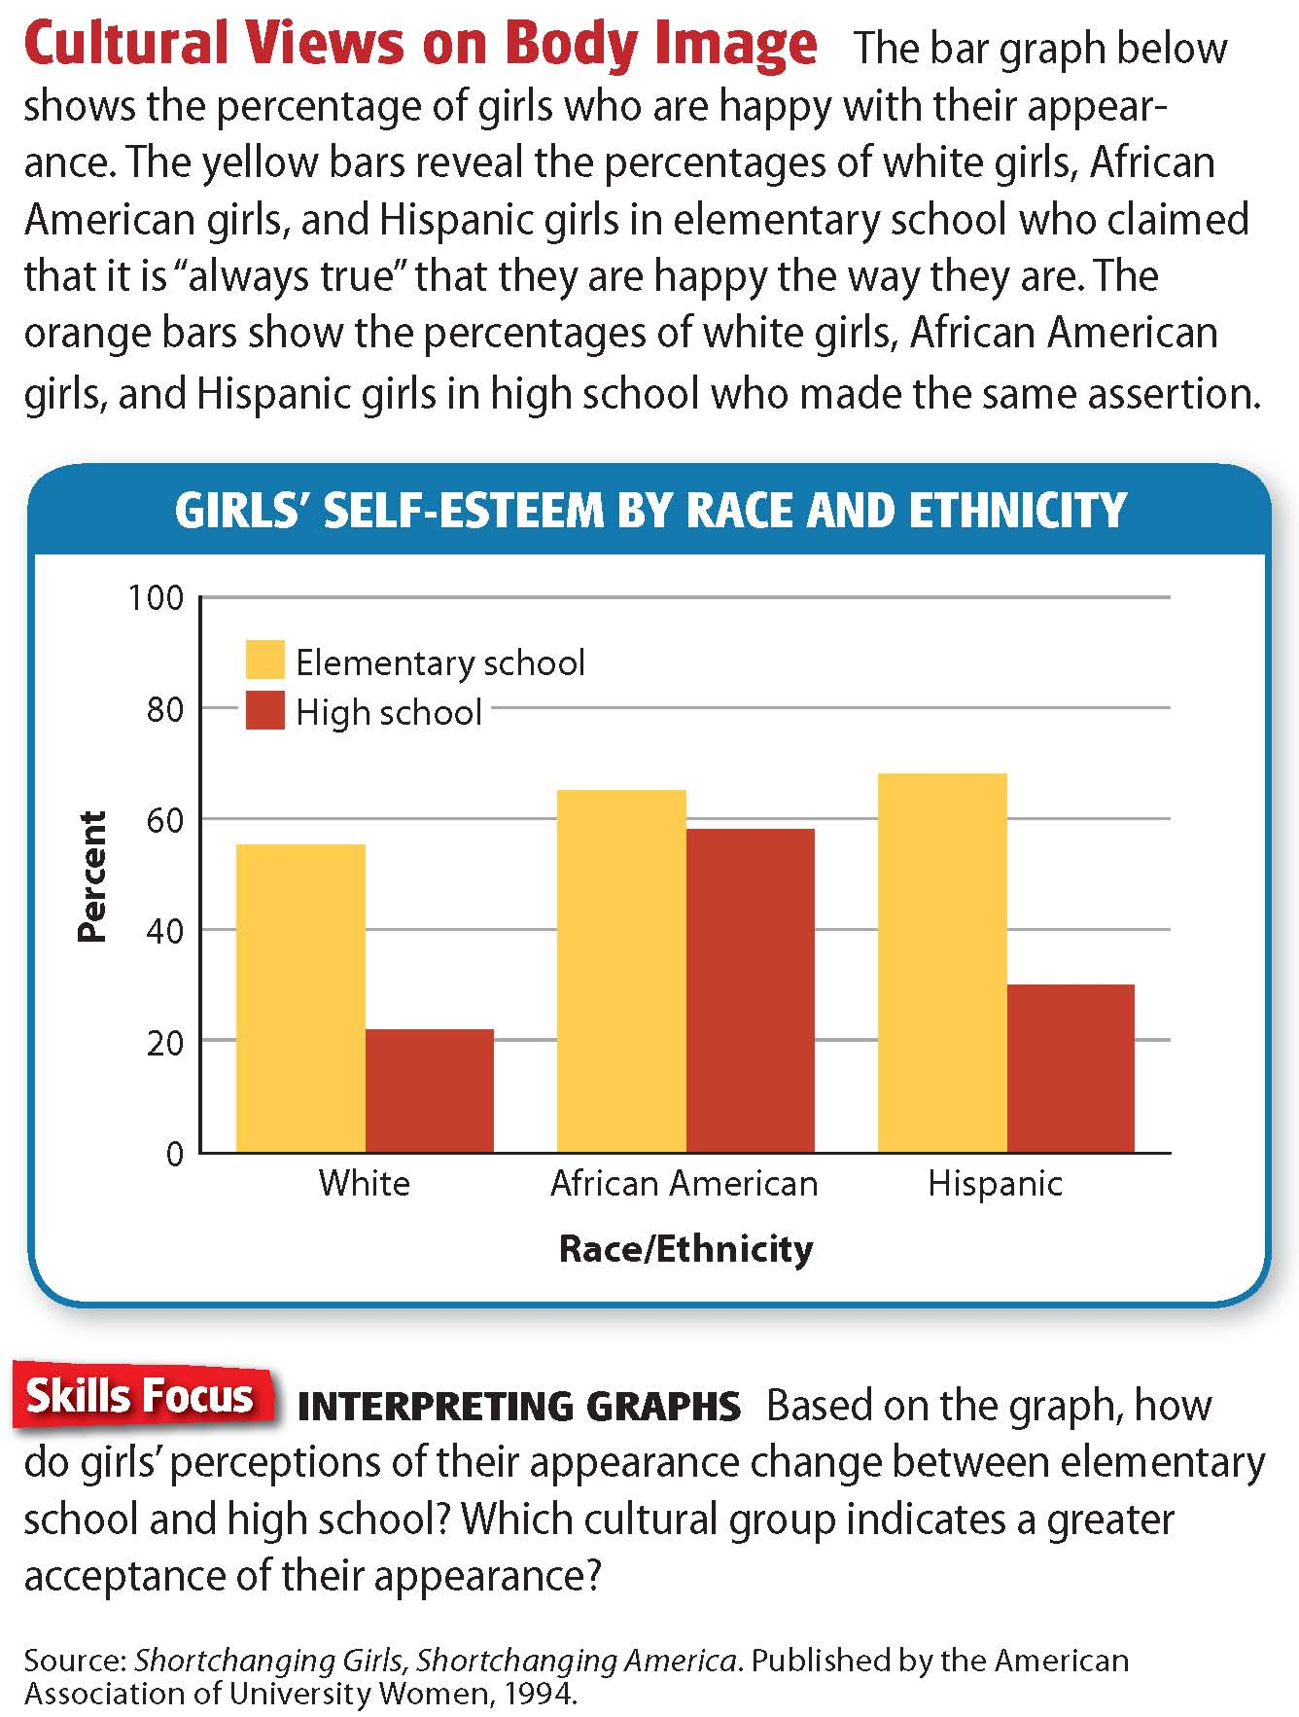

Slide 68
Reading Check
Contrast
What are key differences between an individualistic society and a collectivistic one?
Answer: individualistic—people defined by personal identities and goals; collectivistic—people defined by the groups

Slide 69
Evaluation of the Sociocultural Approach
Provides valuable insights into the roles of ethnicity, gender, culture, and socioeconomic status in personality formation
Allows us to understand how individuals think, behave, and feel about themselves within a given cultural setting
Enhances our sensitivity to cultural differences
Special implications for education:
More attention should be paid to learning tools such as group activities, which may be tied to social and cultural practices.

Slide 70
Reading Check
Make Generalizations
What implications might the sociocultural approach have for learning and education?
Answer: Social and cultural contexts have an impact on learning.

Slide 71
Current Research in Psychology
The Science of Well-Being
“Positive psychology” is a science of the positive aspects of a human life: happiness, well-being, and flourishing. It seeks to bring solid empirical research into areas such as wisdom and creativity.
Psychology seems to focus on the shortcomings and struggles of individuals instead of their potential.
Positive psychology aims to study what sort of life is worth living.
Happiness is partly innate and partly depends on us.
One study shows that well-being is tied to a longer life.
Research indicates that using simple well-being strategies can make people lastingly happy.
Spending time thinking of three things that went well in a day can increase one’s happiness for up to six months.
Notes:
–

Slide 72
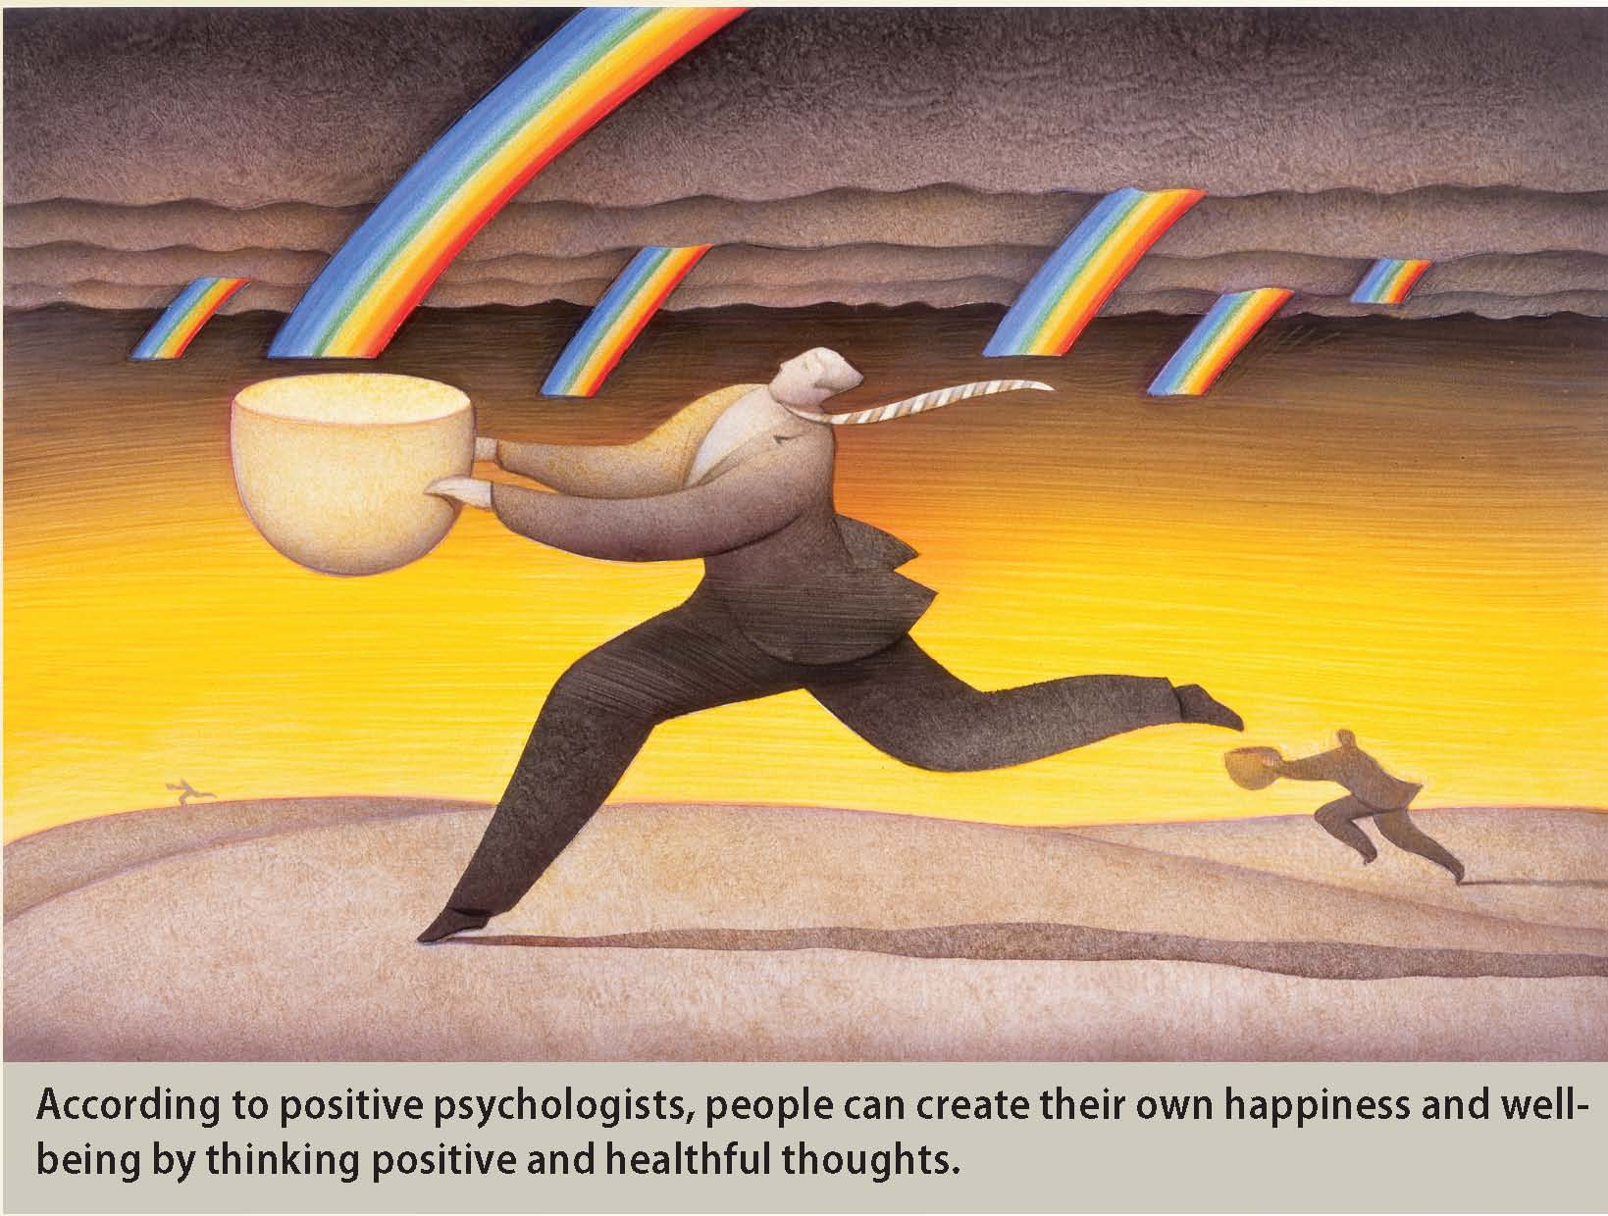

Slide 73
Thinking Critically
Why do you think happy people live longer?
With so much misery and suffering in the world, why should psychologists spend time and resources studying people who are already doing well?

Slide 74
Lab: Applying What You’ve Learned
Your Self: Applying Theories of Personality
Can theories of personality explain what makes you unique?
1. Introduction
2. Profiling Your Personality
In this lab, you will select four of the approaches from this chapter and apply them to your own personality.
Create a collage that illustrates your personality and present it to the class.
Use a graphic organizer to brainstorm a list of personality traits that make you unique.
Notes:
–

Slide 75
Lab (cont'd.)
3. Creating Your Collage
4. Presenting Your Collage
Use your notes and personality profile to create a collage that represents your personality from the four perspectives you chose.
Create an illustration and caption for each of the four parts of your paper.
Write a paragraph explaining which approach to personality most clearly explains your personality.
Present your collage to your classmates without revealing which of the four approaches you chose to illustrate.
Invite classmates to guess which approach is represented.
Using points from your paragraph, explain to the class which approach you think best describes your personality.
Notes:
–

Slide 76
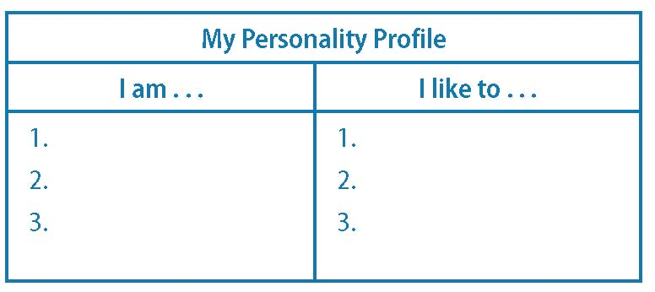
Lab (cont'd.)
5. Discussion
As a class, discuss the following:
What did you learn from this lab?
How successful was the class at applying the different approaches to personality?
Were some approaches easier or harder to illustrate? Why?
Notes:
–

Slide 77
